Slide 1

Natural
Haircare
Using the spirit of Botho (Ubuntu) and always striving to cultivate oneness with nature.
Green Marvel is inspired by the
synergism of man with nature

Slide 2

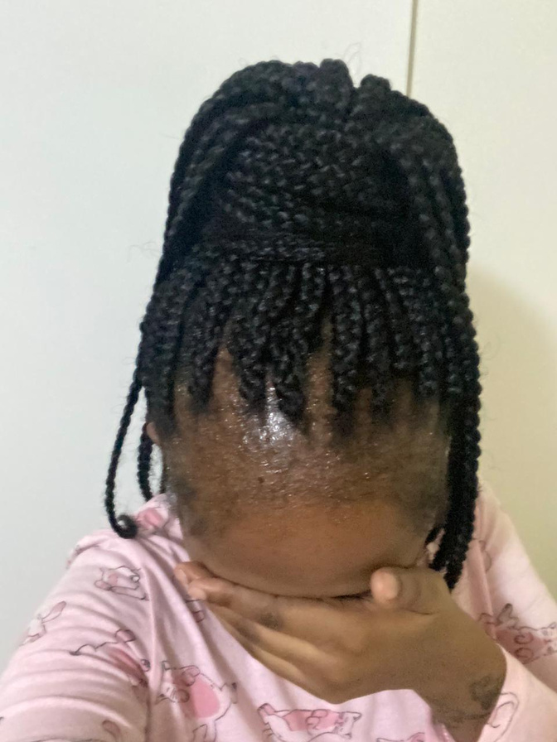
Problem
DAMAGED HAIR AND HAIRLINES
ALOPECIA AND HAIR LOSS
SCALP INFECTIONS
Our products help restore and strengthen hair, promoting healthier growth and improving damaged hairlines
Hair loss due to conditions like alopecia, offering natural solutions to encourage regrowth
Our products are formulated to treat and prevent scalp infections, helping to maintain a healthy scalp and prevent hair loss, especially in children

Slide 3
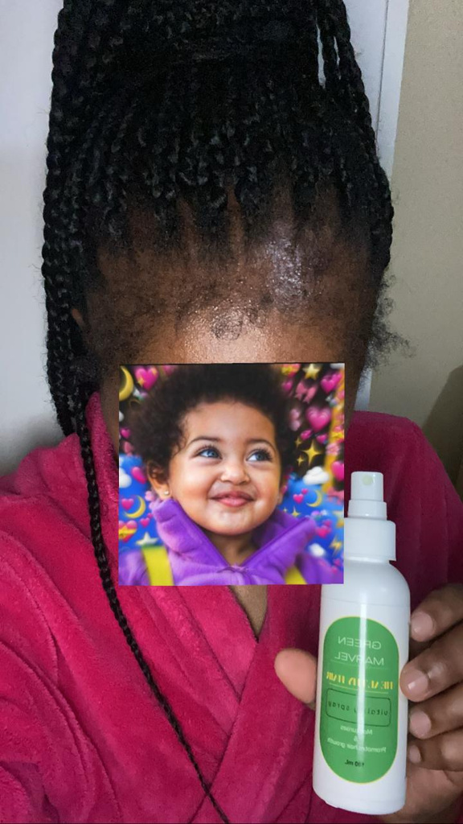
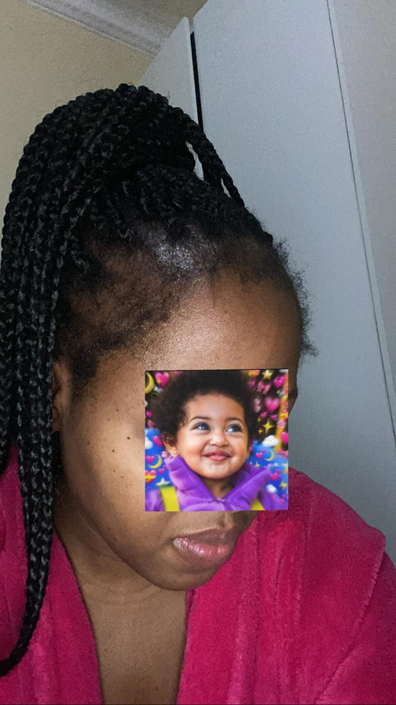


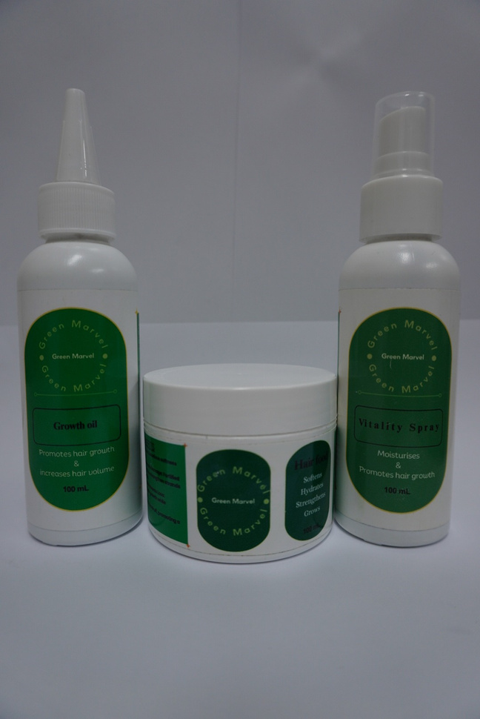
WEEK 1 WEEK 2 WEEK 4
RESTORING HAIRLINES
The Hair Spray repairs hairlines, promotes growth, moisturizes, and retains color
Solution
PREVENTING BREAKAGE
The Hair Food hydrates, strengthens, and prevents breakage and split ends
PROGRESSIVE HAIR GROWTH
The Growth Oil nourishes, hydrates, and promotes long-term hair growth

Slide 4
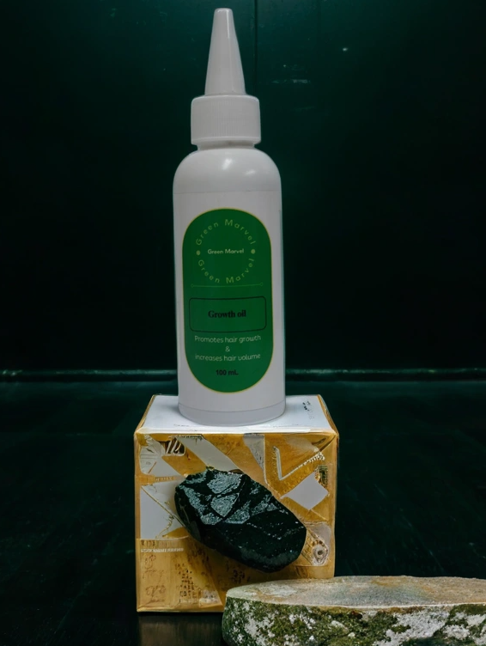

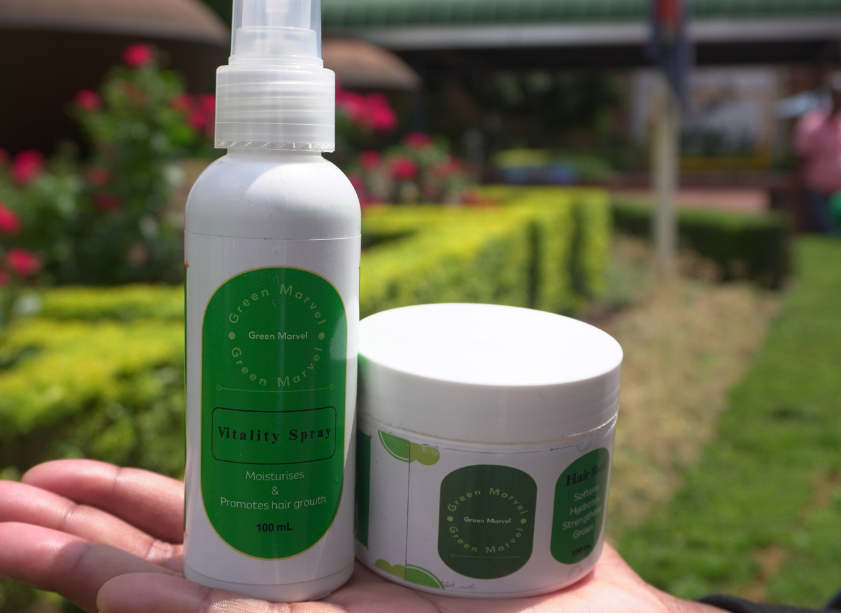
Effective 100% Organic Haircare
Our products designed to promote healthy hair, restore confidence, and address common hair and scalp issues naturally

Slide 5

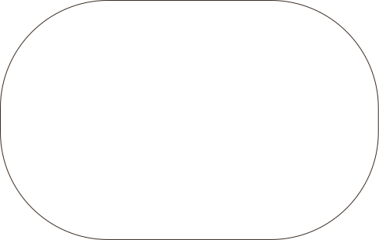
Birth of Green Marvel
FINAL PRODUCT
We’ve seen how many people struggle with confidence due to hair issues—some wear wigs to cover damaged hairlines, while others choose to go bald rather than face the emotional toll of hair loss or conditions like alopecia.
We also recognize the distress children experience when dealing with scalp infections that result in hair loss, often leading to teasing and cruelty from their peers.
Green Marvel was created to help prevent these painful experiences by offering natural, effective solutions that promote healthy hair and restore confidence, especially for those who need it most
2023
PROTOTYPE
2023
IDEA
2021

Slide 6



STRENGTH
OPPORTUNITY
Green Marvel offers high-quality, 100% organic haircare products that meet the growing demand for natural beauty solutions
Growing consumer interest in sustainable and eco-friendly products presents significant market growth potential
SWOT
Analysis
WEAKNESS
THREAT
Limited product range, with the shampoo still in development, which may slow overall brand expansion
Intense competition from established haircare brands and new entrants in the organic beauty space

Slide 7


REASON 1
Green Marvel has already demonstrated strong customer loyalty with over 80% retention on key products like the hair spray and hair food, indicating that demand is strong and there's a solid foundation for expansion
Timing
REASON 2
With a growing product range and increasing sales, Green Marvel is positioned to scale production and meet the demand for organic, affordable haircare solutions, especially as the brand’s visibility grows through influencer partnerships and digital marketing
Proven Customer Retention
Scalability of Production

Slide 8
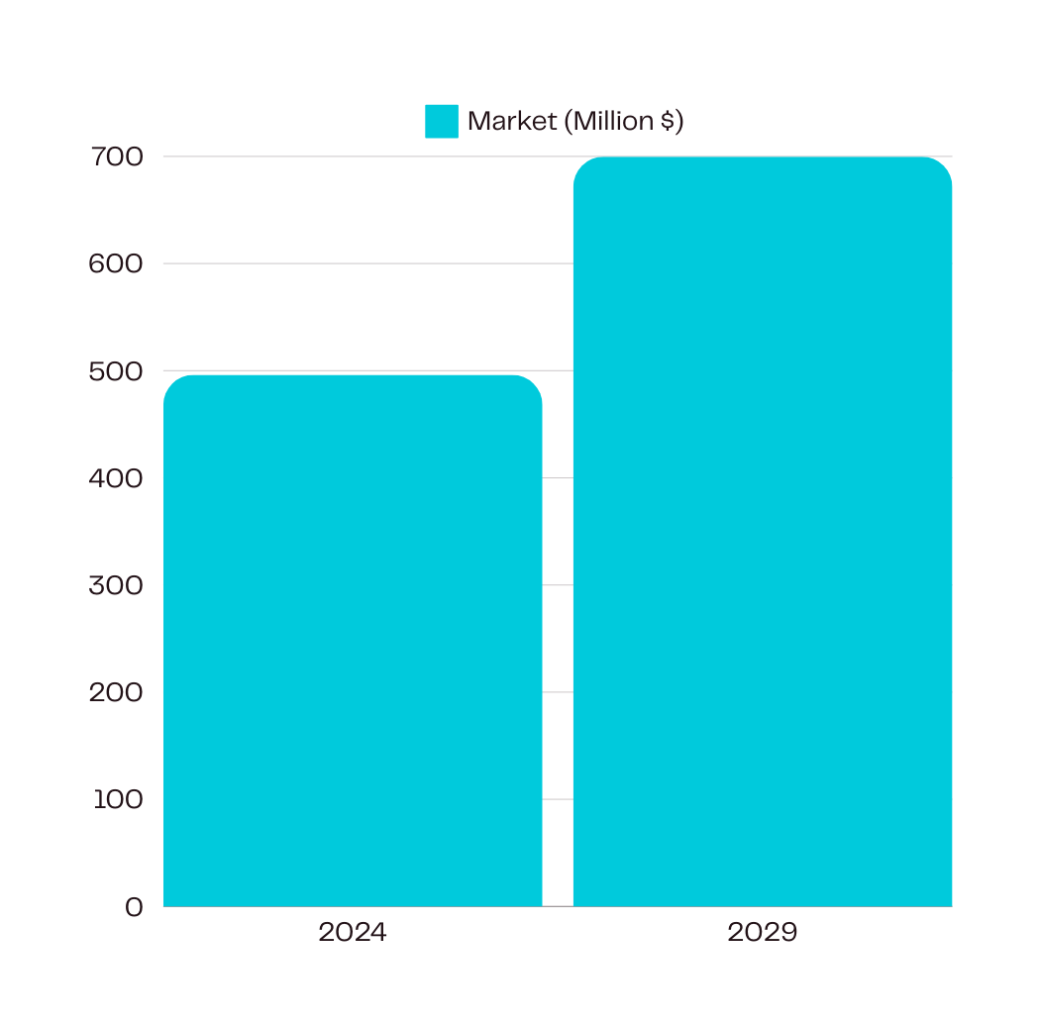

MARKET OPPORTUNITY
Growing demand for Organic hair products
The growth of the South African hair care market can be attributed to several key factors, including increasing consumer awareness of hair health and a preference for organic, natural products. Rising disposable incomes have led to more spending on premium beauty products, while the influence of social media and beauty trends has spurred demand for innovative solutions. Additionally, the diverse range of hair types has led to the development of specialized products, and growing consumer interest in sustainable, eco-friendly options has further fueled the market's expansion

Slide 9
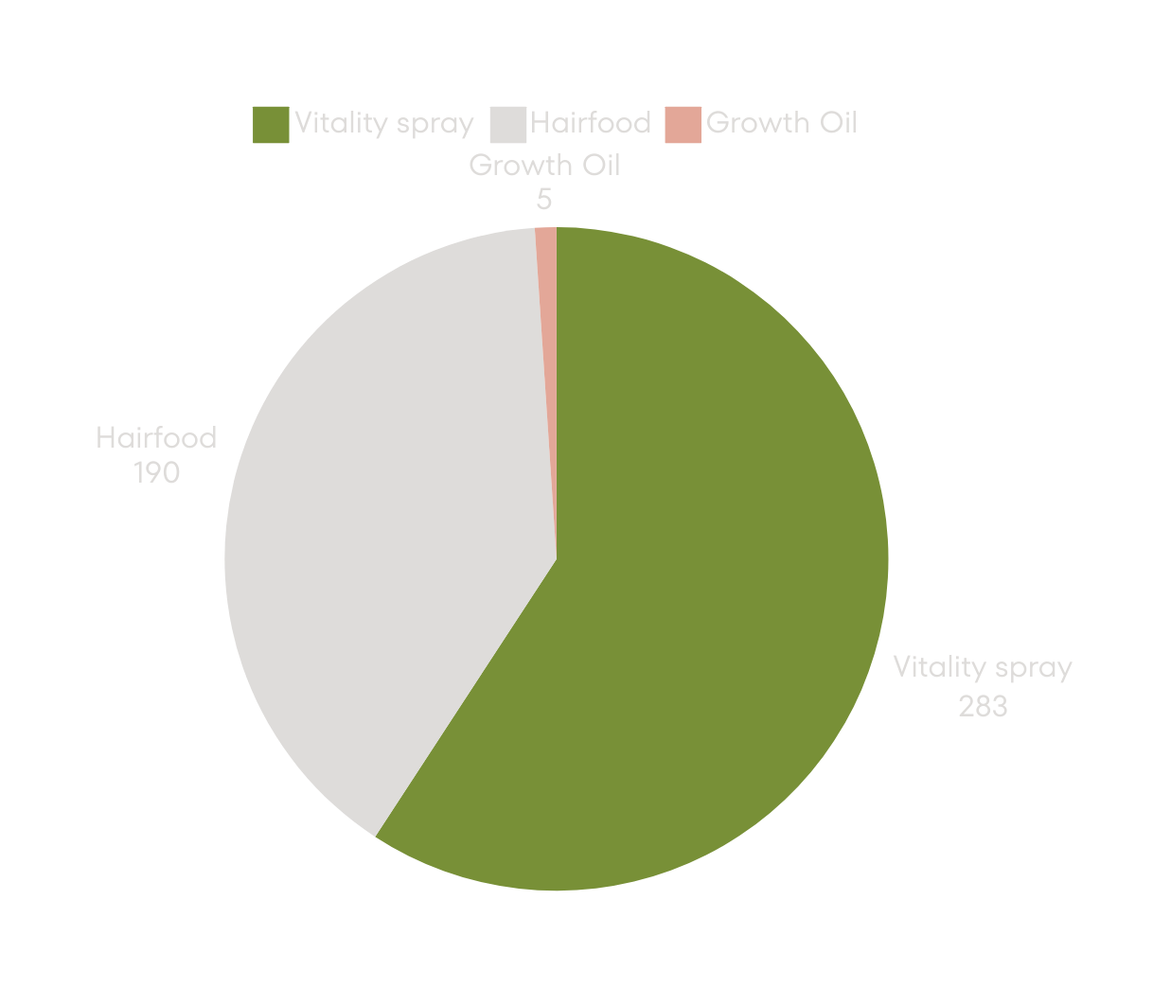

Sales
Green Marvel has managed to sell 478 products combined.
Our target for 2025 is to sell 1000 products in the 1st quarter.

Slide 10

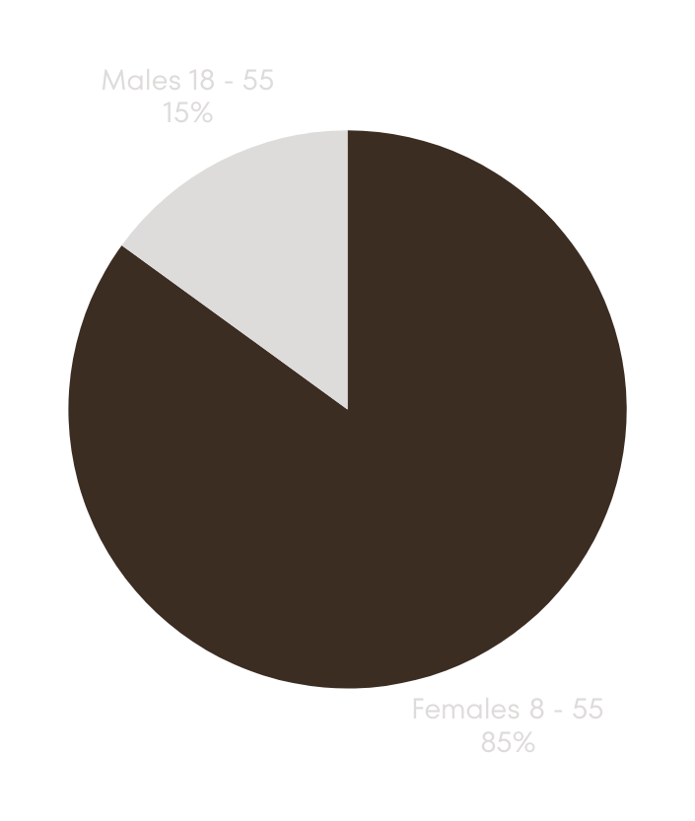
Target Market
FEMALES
Health-conscious and seeking natural, organic haircare solutions to maintain or improve their hair health
MALES
Seeking to reduce symptoms of alopecia and grow hair or beard

Slide 11


Green Marvel’s marketing strategy will focus on digital channels, leveraging social media platforms like Instagram and Facebook to connect with health-conscious consumers.
We will collaborate with influencers in the beauty and wellness space to build brand credibility and expand reach. Additionally, we will invest in targeted Google Ads and SEO strategies to drive traffic to our website and increase sales.
As we grow, we’ll explore partnerships with online retail platforms like Takealot and expand into physical retail to further increase brand visibility
Marketing Strategy
https://greenmarvel.co.za

Slide 12

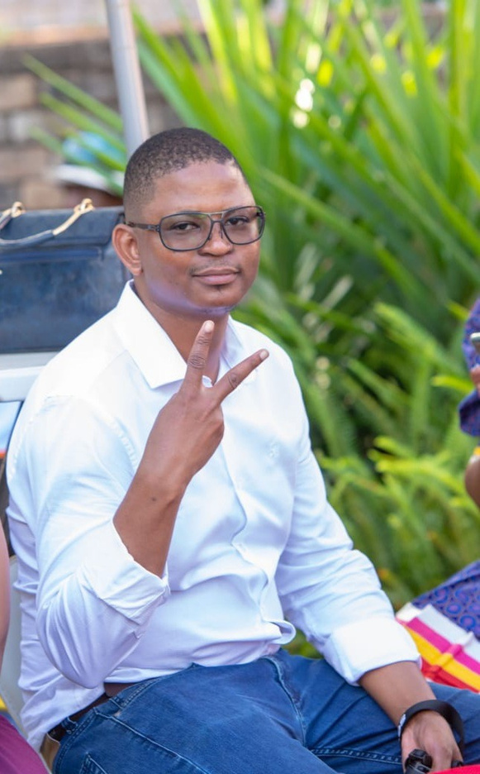
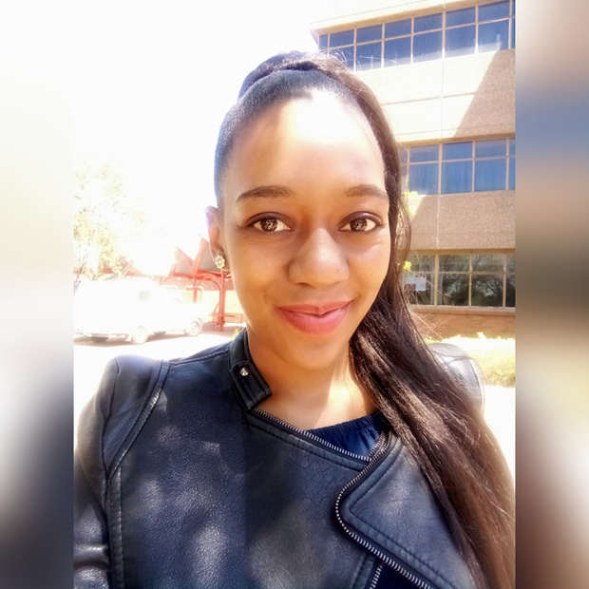
Our Team
RAMOAGI T SEGONE
BUSISIWE V MAPHANGA
Founder
Founder

Slide 13

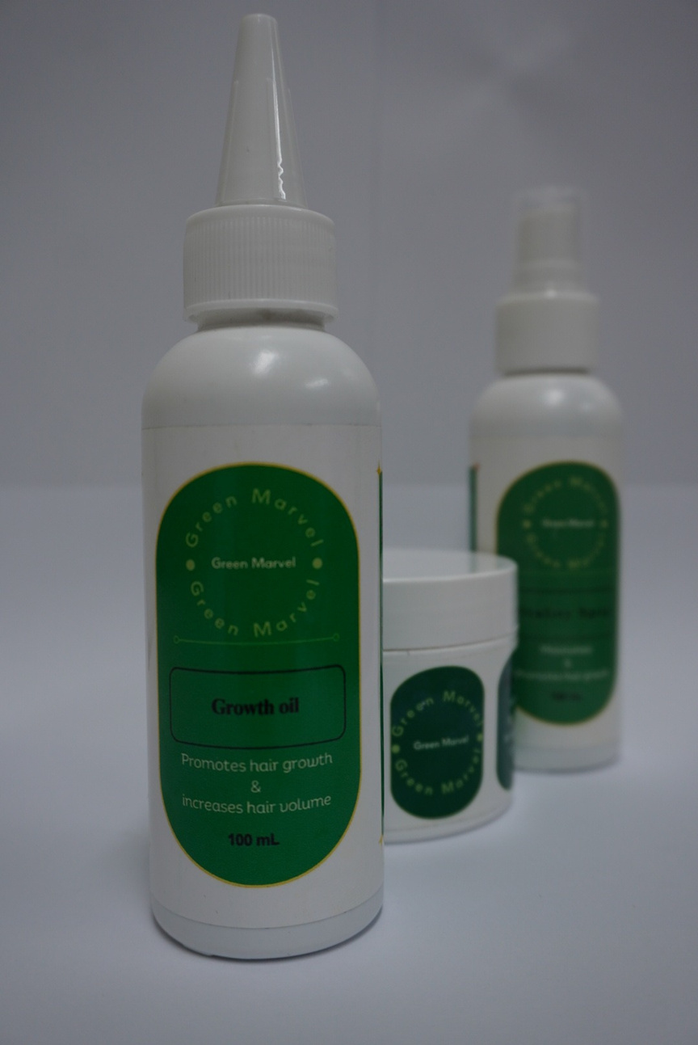

Contact Us
PHONE NUMBER
081 752 3336
SOCIAL MEDIA
EMAIL
@green.marvel.sa
admin@greenmarvel.coza
WEBSITE
MAILING ADDRESS
https://greenmarvel.co.za
620 Park Street

